Slide 2

08
Lesson 08
Similar Triangle III

Slide 3
Part 1
Connect Proper Segment

Slide 4
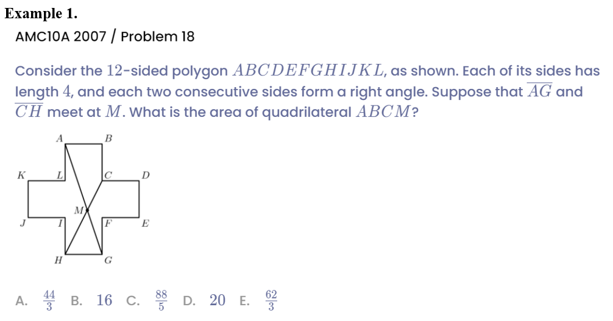
Example

Slide 5
Part 2
Draw Proper Parallel Lines

Slide 6
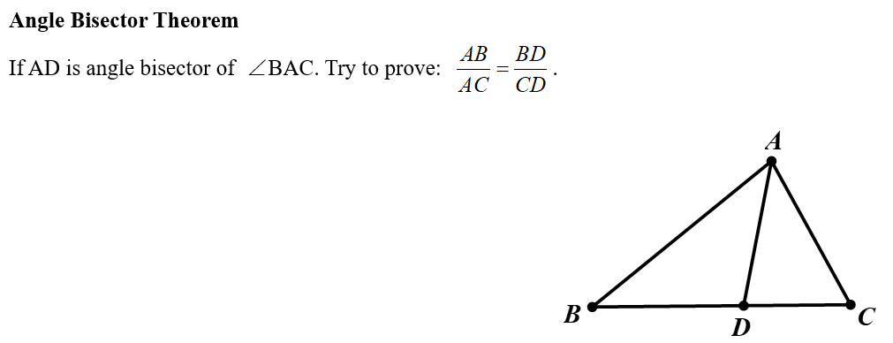
Lead in

Slide 7
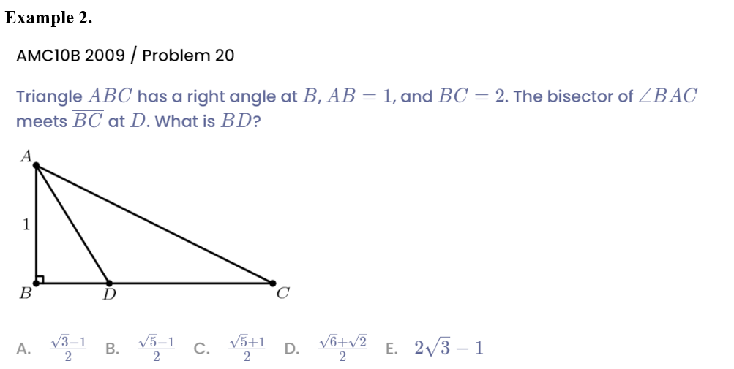
Example

Slide 8
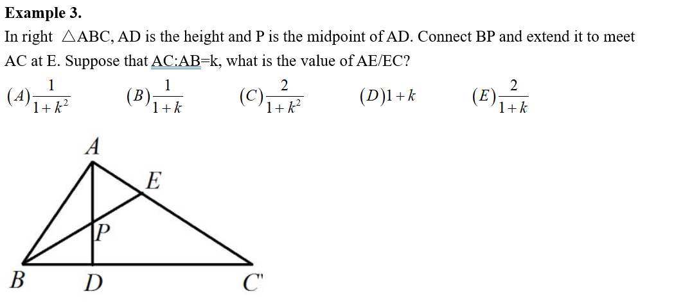
Example

Slide 9
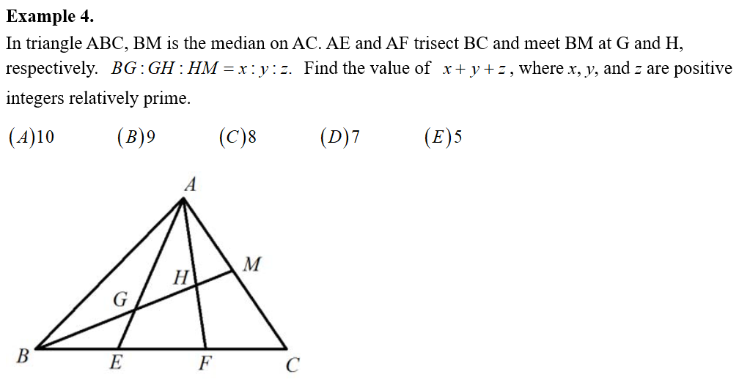
Example

Slide 10
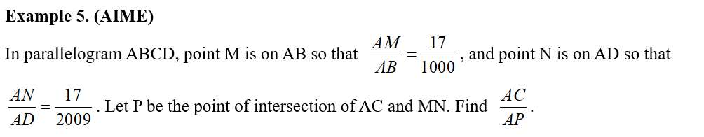
Example

Slide 11
Part 3
Draw Proper Perpendicular Lines

Slide 12
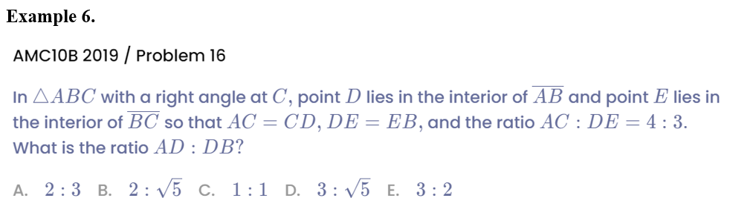
Example

Slide 13
Part 4
Draw Proper Extension Lines

Slide 14
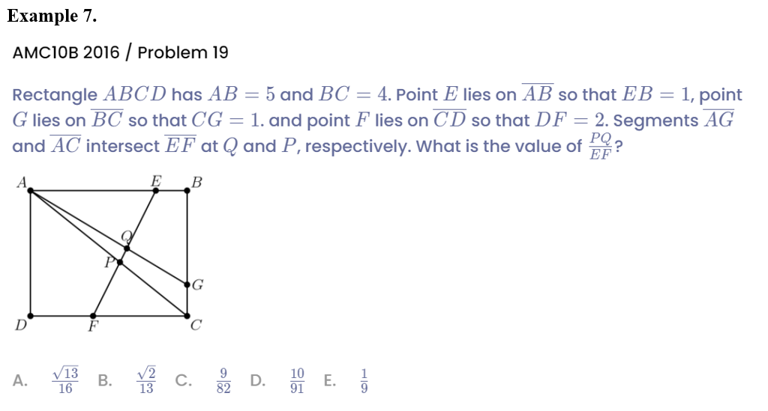
Example

Slide 15
Part 5
Complex Similar Triangle with Auxiliary Lines

Slide 16
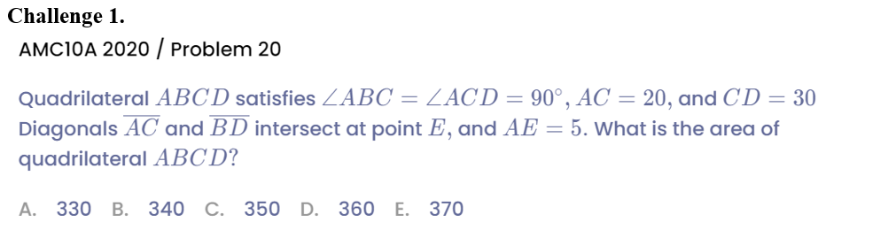
Example

Slide 17
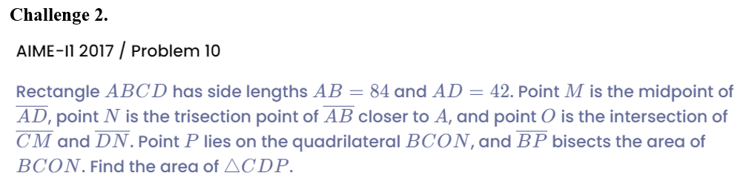
Example

Slide 18
See You Next Time!

